Slide 1
Wicked Smaht Team
Lalitha Agnihotri
Dmitri Artamonov
Aaron Merlob
John Sanders

Slide 2
Abstract/Exec Summary
Essential Question:
Can the success or failure of a Donors Choose campaign be predicted?
Guiding Framework for Data Analysis:
What are some traits of a successful campaign funded on Donors Choose?

Slide 3
Primary Data
Features Information:
Key Metrics:
Success logical; amount raised/amount asked
Success Rate num (proportion, successful/total)
Success Ratio num (ratio, successful/failed)
Data:
178,095 unique recipients
224,659 unique donors
401,549 unique projects
Project size | Donation received
Month/Day of origination | Poverty level
Primary focus subject | Primary focus area
Home state of project | Resource type (books, technology, trips, visitors, supplies, other)

Slide 4
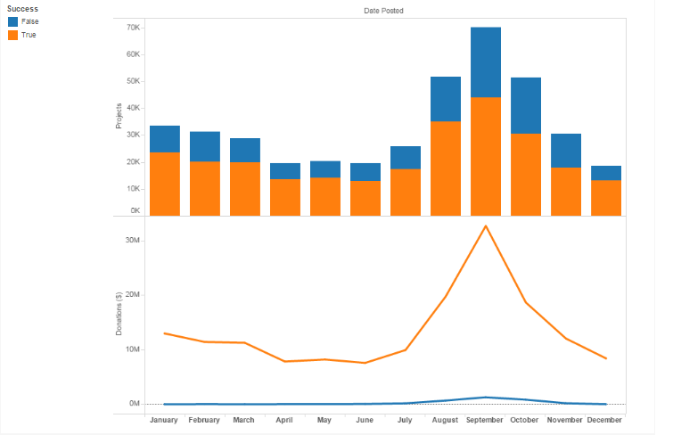
Project Success by Month

Slide 5
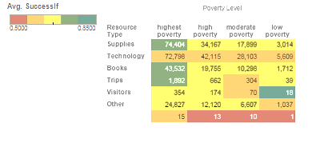
Resource Type v. Poverty Level

Slide 6
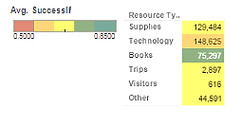
Project Success by Resource Type

Slide 7
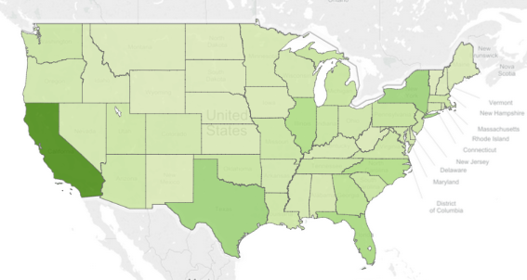
Projects by State

Slide 8

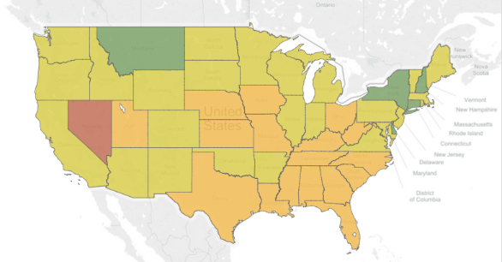
Success by State

Slide 9
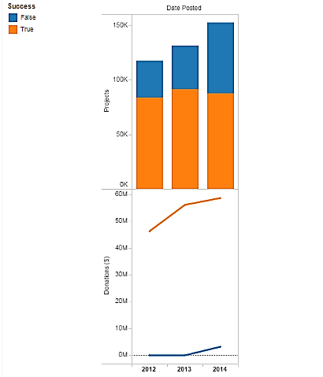
3-Years’ Annual Projects
Number of new projects are going up while number of projects succeeding remain stable.
Amount of money donated increased approximately 33% from $45M to $60M+
(including $3M+ toward unsuccessful projects in 2014).

Slide 10
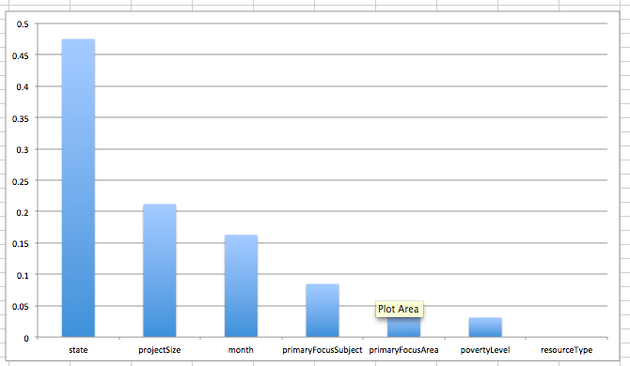
Feature Importance

Slide 11
Prediction Modeling
Trained KNN model with 401 thousand project information
Used State, Project Ask Size, Month, Primary Focus Subject, Primary Focus Area, and Poverty Level as features
Numbers for correctly labeling failed projects as such:
AUC: 0.56
Recall: 23.8%
Precision: 50.6%
Overall accuracy: 65%

Slide 12
Recommended Further Analyses
Need to do social network analysis
More features
Text sequences/character strings from essays
Frequency of project characteristics/types
Elements of appeal e.g. descriptors, tone
Non-economic, non-geographical meta data correlations
Smarter models: Ensemble…

